Slide 1
Quality Circle Forum of India
presents
Problem Solving Techniques
- a simplified revised practical guide

Slide 2


Slide 3
DATA COLLECTION

Slide 4
What is Data collection?
Data collection is nothing but the collection of the required ‘information’ in figures for the statistical analysis of a problem. This provides a sound basis for decision making and corrective action.

Slide 5



Anything we do we would like to evaluate to find out whether we are doing it rightly.

Slide 6


For conventional function, our evaluation is normally based on past experience

Slide 7

Sir, I think we
should rely only on facts before taking any decision
But basis or guidance for decision is facts.

Slide 8

Did I not tell you that the prices of my stocks are going to sky rocket. My sixth sense never fails me.
Experience and sixth sense may be necessary

Slide 9


However, these are liable to invite error in judgment due to the decision being too personal or out of erroneous memory.

Slide 10

To avoid this, it is important to get the facts in terms of numbers or quantity.

Slide 11
TYPE NUMBER CUM % OF CUM
OF OF TOTAL %
DEFECT FANS
F. Regulator 40 40 27% 27%
G. Bend in Screws 25 65 17% 44%
A. Motor winding 20 85 13% 57%
B. Bend in wings 15 100 10% 67%
C. Cracks in Central rod 14 114 9% 76%
E. Scratches 12 126 8% 84%
D. Capacitor 10 136 7% 91%
H. Others 14 150 9% 100%
Total 150 100%
These numbers are called data. They are expression of facts of any activity or feature in numerical terms.

Slide 12

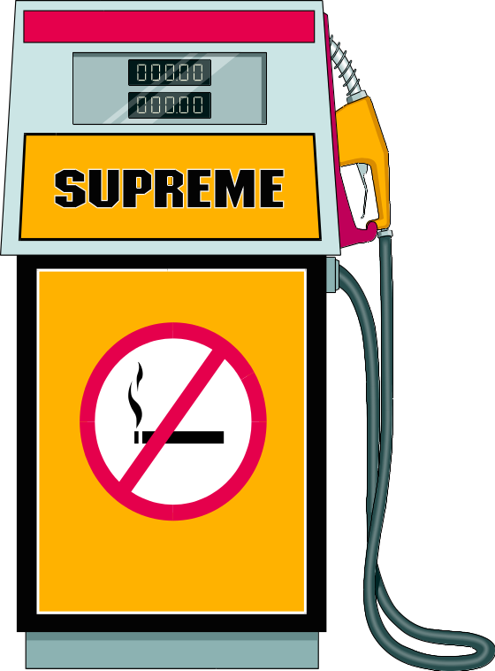
MILEAGE : 55 Km/litre
Examples: Fuel efficiency of a scooter,

Slide 13

Clock speed
233 Mhz.
Clock speed of a computer

Slide 14

CUSTOMER COMPLAINTS
3000 complaints in four months
Volume of customer complaints

Slide 15

100 degree Celsius
Boiling point of water

Slide 16
PURPOSE OF DATA COLLECTION

Slide 17

Data are collected for a variety of purposes.
In industry, the following are more common.

Slide 18

QUALITY CONTROL DEPARTMENT
Quality Evaluation
Raw materials, semi finished products and finished products

Slide 19

Process Control
To assure that products turned out meet specified requirements of customer/design.

Slide 20
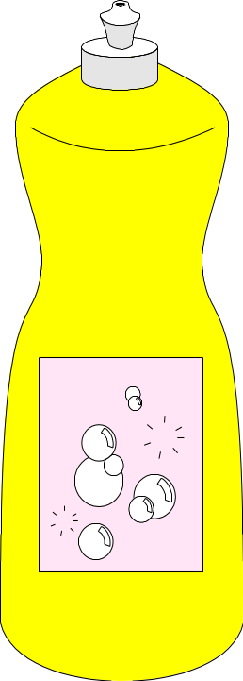

GOOD DETERGENT GOOD DETERGENT
HIGH PRICE LOW PRICE
Improvement Trials - To improve product quality, reduce costs and increase productivity

Slide 21
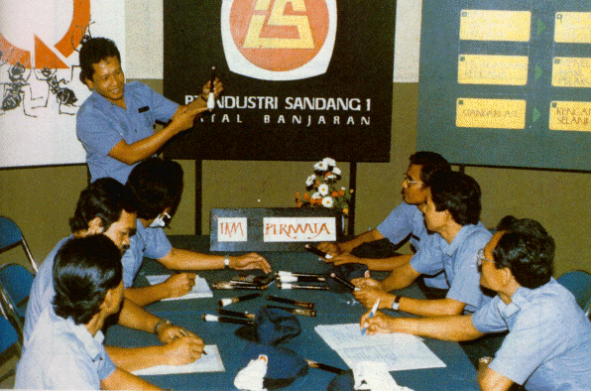
Problem Solving
For information through out the problem solving process by Quality Circles

Slide 22
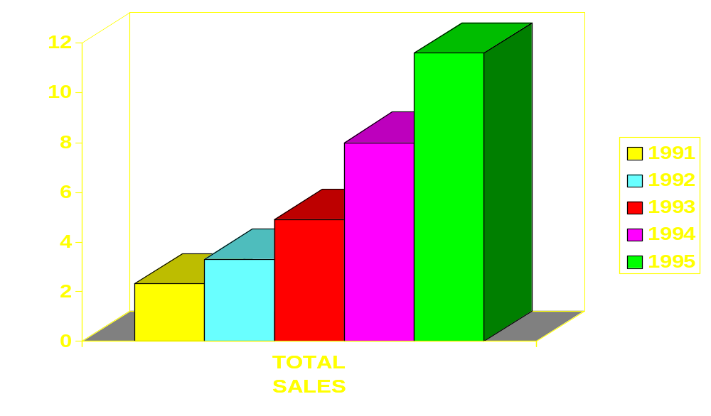
Total sales of VIJAY CHAIN OF SUPERMARKETS (in crores)
Compare Performance
From time to time measure improvement in production, profit, quality, competitiveness etc.

Slide 23
TYPES OF DATA
Generally data are of two types:
a) Measurement data
b) Attribute data

Slide 24
Measurement data
Diameter of a Steel Wire measured using a screwgauge
1st 2nd 3rd 4th
Diameter of the steel wire (in cm)
0.156 0.152 0.153 0.156
Weight, diameter, tensile strength, % carbon, reaction time etc. Basic observation obtained by using an instrument or measuring process.

Slide 25
Measurement data
SOLDER BATH TEMPERATURE
TIME TEMPERATURE
0800 62 C
0900 61 C
1000 59 C
1100 58 C
1200 60 C
1300 64 C
1400 63 C
These data are continuous, they are also called continuous variable. A variable is one which varies i.e takes different values. Time, for instance is a continuous variable.

Slide 26
Attribute Data
SEPTA LIMITED
NUMBER OF TRUCK TYRES REJECTED AND PASSED BY THE QUALITY CONTROL DEPARTMENT
DURING THE MONTH OF JANUARY 1996
TYRES REJECTED TYRES PASSED
JANUARY 1996 5000 22000
Data obtained by classification into two or more categories.

Slide 27
Attribute Data
SEPTA LIMITED
NUMBER OF TRUCK TYRES REJECTED AND PASSED BY THE QUALITY CONTROL DEPARTMENT DURING JAN-JUN 1996
TYRES REJECTED TYRES PASSED
JAN 1996 5000 22000
FEB 1996 2000 25000
MAR 1996 7000 20000
APR 1996 1000 26000
MAY 1996 2000 25000
JUN 1996 8000 19000
These data are in whole numbers and are called discontinuous or discrete variables.

Slide 28
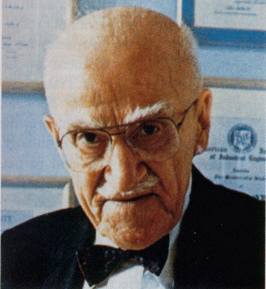
Attribute Data
Collection of information or generation of information as Dr. Juran says begins and ends with questions.

Slide 29
Attribute Data
WHY
WHEN
WHAT
WHO
WHERE
HOW
Skill in collection of information lies in asking the right questions using the 5 - W’s & 1 - H.

Slide 30
CHECK SHEET
An easy and effective way of collecting data is by using well designed formats. A check sheet is a simple data recording form specially designed so that data can be interpreted readily from the sheet itself.

Slide 31
SOLDER BATH TEMPERATURE
CHECKED BY : DATE:
TAKE READING OF TEMPERATURE NEAREST TO DEGREE.
TIME TEMP (deg. cel.)
TIME TEMP (deg. cel.)
Items to be checked are pre-printed so that recording becomes very easy.

Slide 32
Check sheets are of the following types:
a) Process control information checks
b) Product quality assurance checks
c) Defective item checks
d) Defect location checks
e) Defective cause checks
f) Process variation distribution checks
g) Others

Slide 33
PROCESS CONTROL INFORMATION CHECK

Slide 34

PROCESS CONTROL INFORMATION CHECK
This format enables to record process control checks.

Slide 35
PROCESS CONTROL INFORMATION CHECK
SOLDER BATH TEMPERATURE
CHECKED BY :Preeti DATE:18-6-98
TAKE READING OF TEMPERATURE NEAREST TO DEGREE.
TIME TEMP (deg. cen.)
TIME TEMP (deg. cen.)
0800 60 1300 61
0900 62 1400 58
1000 59 1500 63
1100 58 1600 63
1200 59 . 1700 59
Note: Power failure from 12.00 to 12.15 hours

Slide 36
PRODUCT QUALITY ASSURANCE CHECK

Slide 37

PRODUCT QUALITY ASSURANCE CHECK
This check sheet is useful in the final test of the product at the end of manufacturing line

Slide 38
PRODUCT QUALITY ASSURANCE CHECK
The purpose of the check is not the check of only the final assembly or operation but to carry out a comprehensive check of quality that has been built through the previous stages.

Slide 39
PRODUCT QUALITY ASSURANCE CHECK
Actual Observation
No
PARAMETER
Space 1 2 3 4 5
1. Axial clearance 0.1.0.45 6.3 0.18 0.22 0.17 0.21
2. Cleanliness of Crank S Clean OK OK Not OK OK OK
3. Surface finish 0.4 300 320 325 315 300
:
:
:
:
24. Paint Finish Glossy OK OK OK OK OK
An example of format used for checks on diesel engine at final end is shown here.

Slide 40
PRODUCT QUALITY ASSURANCE CHECK
Permanent records of the product quality assurance check sheets.
It is clear that all facts are made without fail. This way there is no chance of forgetting and the check sheets remain as a permanent record that can be referred back later whenever necessary

Slide 41
CHECK LIST TYPE CHECK SHEET

Slide 42

CHECK LIST TYPE CHECK SHEET
Look at Check Sheet for maintenance work

Slide 43
CHECK LIST TYPE CHECK SHEET
Frequent checks must be made to keep equipment work efficiently and trouble free.

Slide 44
CHECK LIST TYPE CHECK SHEET
Some checks are made daily, others weekly, still others monthly or at fixed intervals.

Slide 45
CHECK LIST TYPE CHECK SHEET
With even the slightest absent mindedness, it is easy to forget a check up or even whether a check was really made or not

Slide 46
CHECK LIST TYPE CHECK SHEET
M/L No.: Shop manager :
Location: Supervisor:
Months
Component Check Points
J F M A M J J A S O N D
Drive Noise
Gear Box Vibration
Bearing Temperature
Transmitter Operation
ELECTRIC
Motor
Control Operation
Wiring Age
Instrumentation
In such cases, a check sheet helps to carryout work with certainty; it will also reveal forgotten test items.
Example: Preventive maintenance of a plastic moulding machine

Slide 47
DEFECTIVE ITEMS CHECKS

Slide 48

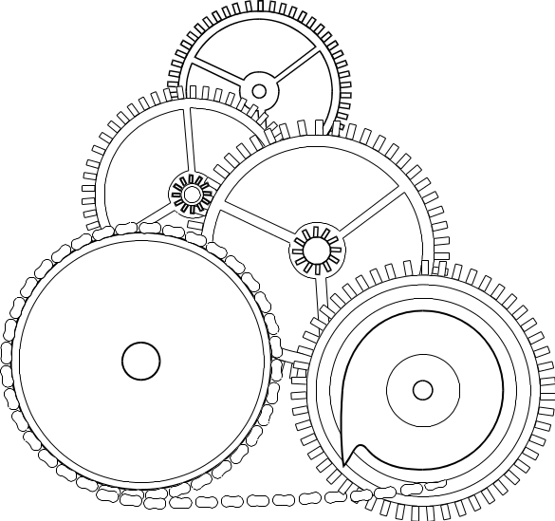
DEFECTIVE ITEMS CHECKS
To reduce the number of defectives, it is first necessary to
know the type of defects and their magnitude

Slide 49


DEFECTIVE ITEMS CHECKS
Since each defect may have different causes, it is of no use just to list the total number of defects.

Slide 50
DEFECTIVE ITEMS CHECKS
SI No. DEFECT
TALLY
1. BARE METAL //// //// //// //// //// //// //// //// //// //// //// ///
2. OVERFLOW //// //// //// //// //// //// //// //// //// //
3. DUST //// //// //// //// //// //// //// //// //// //// //// //// //// //// //// ////
4. LESS GLOSSY //// //// //// //// //// //// //// ////
5. PAINT PEEL //// //// //// //// //// //// //
*
*
*
17. OTHERS ////
58
47
80
40
32
4
Let us look at the tally of inspection results on painted refrigerator doors as they come out of the painting booth.

Slide 51
DEFECTS LOCATION CHECK SHEET

Slide 52

DEFECTS LOCATION CHECK SHEET
This kind of check sheet is meant to be placed in the drawing or sketch of the product so that location of defects can be identified and investigated.

Slide 53
DEFECTS LOCATION CHECK SHEET
CHECK SHEET (IN PICTURE) DEFECT IN CHIPS
FUNCTIONAL REJECT
PARAMETRIC
REJECT
Defects in chips were located as shown here.

Slide 54

DEFECTS LOCATION CHECK SHEET
Clues to control of defect in chips can be obtained from this

Slide 55
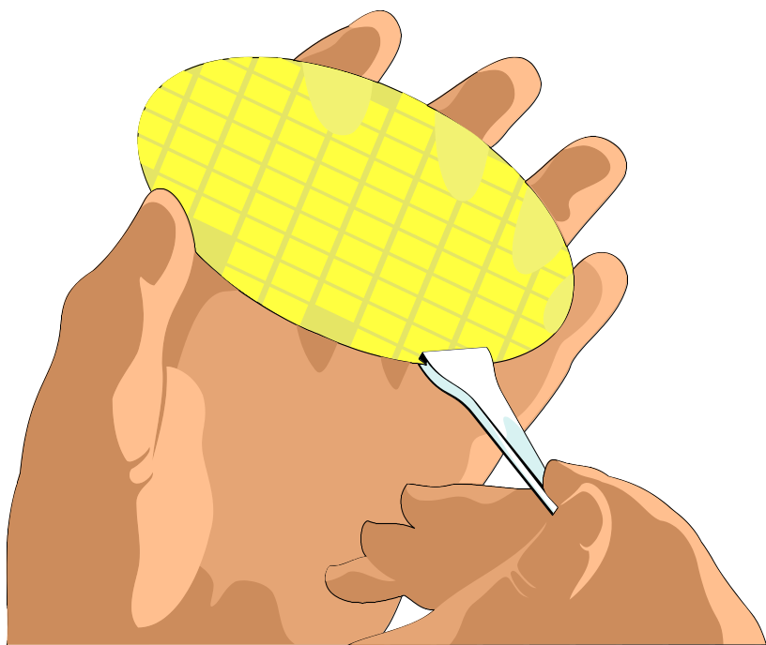
DEFECTS LOCATION CHECK SHEET
Such check sheets are helpful in controlling defects in castings, glassware, plastic components etc.

Slide 56

DEFECTS LOCATION CHECK SHEET
As can be seen, this type of check sheet leads to quick action and is an important tool in process analysis.

Slide 57
DEFECTIVE CAUSE CHECK SHEET

Slide 58
DEFECTIVE CAUSE CHECK SHEET
This type of check sheet is used to generate information on
causes and their correspondence to the observed defects.

Slide 59
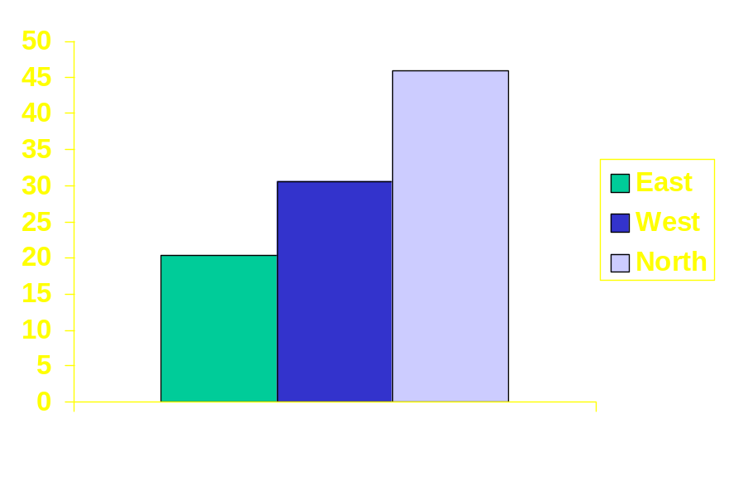
DEFECTIVE CAUSE CHECK SHEET
.
.
.
.
.
.
.
.
.
.
.
.
.
After
.
.
.
.
.
.
.
.
.
.
.
.
.
.
.
.
.
Before
Data may have to be later analysed by stratification or scatter diagram to get clues.

Slide 60
DEFECTIVE CAUSE CHECK SHEET
Consider the example which shows recording format for defectives in bakelite knobs categorised by workers, machines,
day of the week and type of defects.

Slide 61
DEFECTIVE CAUSE CHECK SHEET
M/C Operator Monday Tuesday Wednesday Thursday Friday
AM PM
AM PM
AM PM
AM PM
AM PM
oo x ox ooo oooo o oooo
x xx xxx xx ooo xx oo
. ooo . .. ..
x
1
2
1
2
A
B
oxx xx ooo
.
xx oo ..
x
ooo ooo
x
o Surface scratch x Blow hole Poor finish . Distorted Others
By a mere glance, it will be possible to identify which worker or which machine and on which day there is more proneness to produce defectives.

Slide 62
DEFECTIVE CAUSE CHECK SHEET
This is a rough analysis for cause and effect relationship.

Slide 63
PROCESS VARIATION DESCRIPTION CHECK

Slide 64
Process Variation
Checksheet
Measurements taken on a product or rejects of inspection at incoming material stage or in-process can straightaway be recorded in a check sheet to reveal the variation in quality.

Slide 65
Results of inspection on sack-hole thickness of 'nozzles' are recorded in a data sheet as shown.

Slide 66
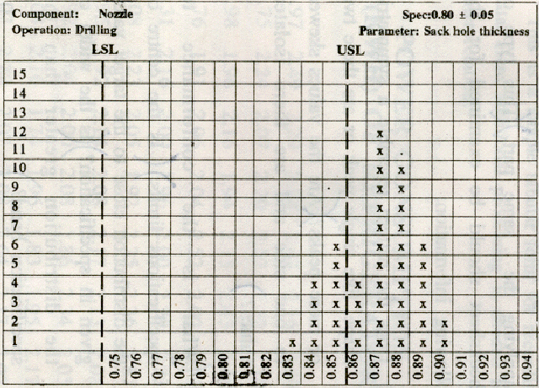
The check sheet shows quickly where is the process set, what is the extent of variation and what is the conformance to specification limits

Slide 67
34 out of 45
Obviously, machine has been set nearer the upper specification limit and hence a large number that is 34 out of 45 are above USL.

Slide 68
0.83 - 0.90
Observed process variation is only 0.83 to 0.90 compared with specification band of 0.75 to 0.85.

Slide 69
Such check sheets are handy in discovering patterns of different vendors supplying the same part. Inferences can be drawn by just looking at the information filled check sheets.

Slide 70

This type of check sheet can be examined for the following information. Does the pattern resemble a symmetric shape, like single peak or are there two or more peaks?

Slide 71
Are the values skewed to one side and are there isolated values?

Slide 72
What is the conformance to specifications limits?

Slide 73
Specification
X
−3σ
+3σ
Is the centre of the distribution close to the target value given in specification

Slide 74
Specification
X
σ
-3
σ
+3
Is the width of the distribution greater than the specification band?

Slide 75
DATA SHEET

Slide 76

This is a simple tabular form for recording data. Here additional processing is needed for interpretation.

Slide 77
POWER CONSUMPTION (kWh) OF REFRIGERATOR
1.97 2.49 2.29 2.24 2.42 2.16 2.89 1.75
2.24 2.07 2.20 2.52 2.32 2.10 1.98 1.96 2.16 1.94 2.13 2.43 2.45 1.76 1.91 2.06 2.04 2.52 2.02 1.95
2.31 2.16 2.00 1.96 2.00 2.29 2.33 2.08 2.23 2.05 1.92 2.25 2.36 1.87 1.95 1.92 2.14 2.08 2.17 2.13 2.08 1.92 2.04 2.00 2.08 1.86 2.34 2.05 2.04 2.16 1.74 1.96 1.83 1.95 2.17 2.02 2.23 2.07 2.08 2.64 2.17 2.02

Slide 78
HOW TO INTERPRET COLLECTED DATA

Slide 79

Before coming to any conclusion from the data collected, it is wise to verify that the data collection was done on the basis of what was required.

Slide 80

Look at the indications of the data collected. Is there any evidence of bias in the collection process, In the number of observations collected, in the number specified etc.

Slide 81
POWER CONSUMPTION (kWh) OF REFRIGERATOR
1.97 2.49 2.29 2.24 2.42 2.16 2.89 1.75 2.24 2.07 2.20 2.52 2.32 2.10 1.98 1.96 2.16 1.94 2.13 2.43 2.45 1.76 1.91 2.06 2.04 2.52 2.02 1.95
2.31 2.16 2.00 1.96 2.00 2.29 2.33 2.08 2.23 2.05 1.92 2.25 2.36 1.87 1.95 1.92 2.14 2.08 2.17 2.13 2.08 1.92 2.04 2.00 2.08 1.86 2.34 2.05 2.04 2.16 1.74 1.96 1.83 1.95 2.17 2.02 2.23 2.07 2.08 2.64 2.17 2.02
The data should be able to answer the questions we ask as the data have been collected on the basis of what we wanted.

Slide 82
It may not be able to answer other questions that we did not anticipate.

Slide 83
SOLDER BATH TEMPERATURE
CHECKED BY : Preeti DATE: 18-6-98
TAKE READING OF TEMPERATURE NEAREST TO DEGREE.
TIME TEMP (deg. cel.)
TIME TEMP (deg. cel.)
0800 60 1300 61
0900 62 1400 58
1000 59 1500 63
1100 58 1600 63
1200 59 . 1700 59
Usually, a check sheet, with its simple collection and analysis format is intended to provide quick answers to simple questions

Slide 84

A complete data sheet however will often support many levels of analysis and stratification, provided they have been anticipated in the design.

Slide 85
ERRORS IN INTERPRETATION

Slide 86

Errors in Interpretation are as follows:
Omit the data from the metros.That should change the picture in our favour.
Exclusion Bias : make sure that no area is left out and what is included has aproper representation in the collection of sample,

Slide 87


Don’t bother, nobody will notice. MD wants it to be introduced immedietly. We will look into the problem later.
Sir, the format is ready. But we have not tested it for accuracy.
Interaction, Perception, Operation Biases

Slide 88
Any one of this can happen, if the formats were not properly and adequately prepared and tested in working condition. Proper training and instruction should be ensured to avoid any or all of such biases.

Slide 89


Sir, we could complete the survey of only 30 segments out of 45 planned. What do we do ?
We have no time. Client wants it urgently. Fill up an average figure for the balance. That will do.
Non Response Bias: never try to fill up with average in places of missing data. Sampling plan is based on different types of population. Missing data can bias the result.

Slide 90
Estimation bias: This bias is beyond our scope. The very system and formulae used to collect data (sample size, types of question etc. may be wrong, causing certain types of biases. You cannot do anything about it unless and until you were the designer of the system.

Slide 91
What makes you think Arundati Roy’s prediction that BJP will win in UP won’t come true.
I say that because the survey was not conducted properly. The questions asked were not properly framed & sample size was too small.
Estimation bias

Slide 92
HOW TO COLLECT DATA

Slide 93

Data can be collected in the following ways:
Formulate good questions that relate to specific information needs of the project.

Slide 94

Consider appropriate data analysis tools and be certain the data needed for the analysis are being collected. Wherever possible, collect continuous (variable) data.

Slide 95

Define comprehensive data collection points.

Slide 96

Select an unbiased collector

Slide 97

Understand data collectors and their environment

Slide 98
M/C Operator Monday Tuesday Wednesday Thursday Friday
AM PM
AM PM
AM PM
AM PM
AM PM
1
2
1
2
A
B
o Surface scratch x Blow hole Poor finish . Distorted Others
  Design data collection forms

Slide 99

Prepare the instructions

Slide 100
Test data collectors.

Slide 101

Audit the collection process and validate the results.

Slide 102
BENEFITS OF DATA COLLECTION

Slide 103

Data collection have the following benefits:
Right decision can be made

Slide 104

Errors due to subjective feeling or personal bias are avoided.

Slide 105

Agreement on decisions necessary rather than different or subjective opinion

Slide 106

Measurement understandable to all

Slide 107

Assessments of magnitude of improvements

Slide 108

I just had a look at the data collected. Is the quality control department sleeping !!
Discovery of causes affecting quality and productivity

Slide 109
USEFUL POINTS FOR DATA COLLECTION

Slide 110

Useful points are as follows:
Be clear in mind about objective

Slide 111

Prepare the question which will make it clear and precise

Slide 112
Collect data relevant to that

Slide 113
Reading in Machine A
1.97 2.49 2.29 2.24 2.42 2.16 2.89 1.75 2.24 2.07 2.20 2.52 2.32 2.10 1.98 1.96 2.16 1.94 2.13 2.43 2.45 1.76 1.91 2.06 2.04 2.52 2.02 1.95 2.31 2.16 2.00 1.96 2.00 2.29 2.33 2.08 2.23 2.05 1.92 2.25 2.36 1.87 1.95 1.92 2.14 2.08 2.17 2.13 2.08 1.92 2.04 2.00 2.08 1.86 2.34 2.05 2.04 2.16 1.74 1.96 1.83 1.95 2.17 2.02 2.23 2.07 2.08 2.64 2.17 2.02
Use data sheet, check sheet and/or check list as per the requirement

Slide 114
Keep them simple and easy and reduce opportunities for error.

Slide 115
Capture data for analysis reference and tractability

Slide 116
FORM
Form should be self explanatory

Slide 117
Analyse the collected data for its credibility and relevance (for whom, when or who collected the data are important.)

Slide 118

Present data in a way that clearly answers the question.

Slide 119
SUMMARY
Most quality improvement tools depend on reliable, accurate data. If such data are not available, they must be collected. The data-collection process must be driven by the ‘information questions’ we formulate based on our information needs. In short, know what question you are trying to answer before you collect any data.

Slide 120

Prepared by
G. Vijaykumar

Slide 121


